Slide 1

LiDAR-based Canopy Cover prediction
May 17th Update
Alejandro Donaire Èric Sánchez Pau Ventura

Slide 2
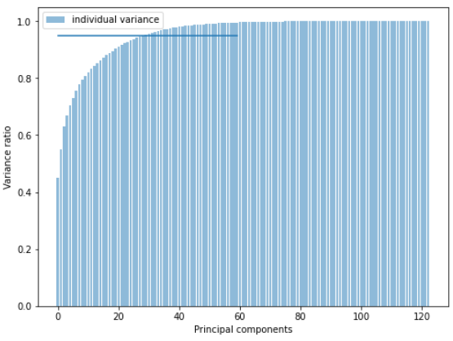
Feature selection (on Fullblock)
+ PCA
118 ~30
Only -0.05 R²
Remains to be seen how this works for a larger amount of blocks

Slide 3
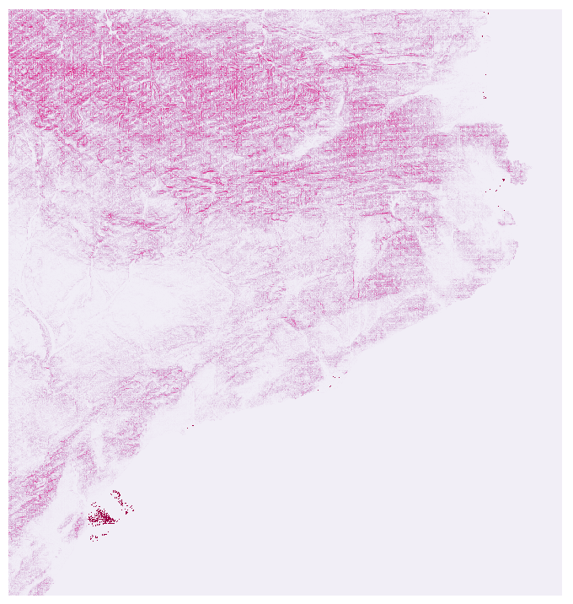
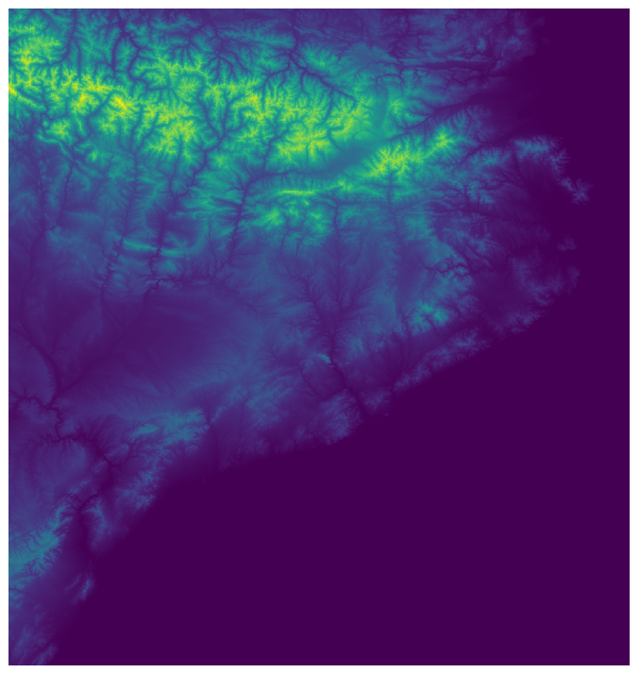
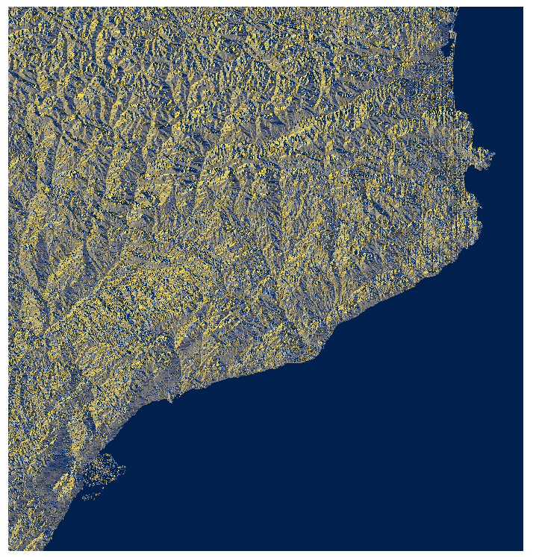
Added aspect, slope and elevation (from LCP)
The resolution is too low (100x100m) → Not a big improvement
What’s the best LCP available?
(used: LCP_CATALUNYA.zip)

Slide 4
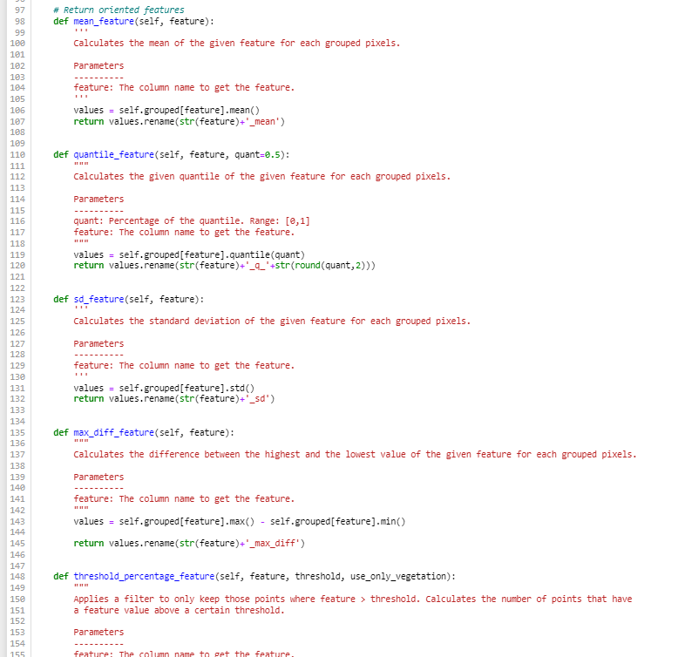
Other technical issues
Simpler Python functions
Clean code
Missing data imputation
Working directly with .laz and .tif
Clear GitHub

Slide 5
Where are we?
Aspect, slope and elevation features (higher res.)
Time features (seasons)
Python script
Feature Selection with more blocks
Hyperparameter Search (probably with ~500 blocks)
Model training full batch

Slide 6
Questions for the team
Will LiDAR points have postprocessing features like class or withheld?
Why don’t you use ICGC’s height map? It is 2x2m
Which LCP file is in 30x30m format?
Could you give us the Landuse file?
ssh problems (direct LiDAR data transfer)

Slide 7
Problems / Research for next week
Upload data to the cluster
Functionize preprocessing
Hyperparameter search at cluster (if we have the LiDAR data)
Optimize code

